Slide 1
Global Software
Product
Development Project
Uppsala (Sweden) Sebastian Persson
Tim Svensson Sudarsan Bhargavan
Hanoi (Vietnam) Thành Công Tran Tuan Dung Ngô
Viet Hai Tran
Turku (Finland)
Shenjie Bao Zijian Wang Ziyu Wang
TEAM 5
Notes:
ALL TEAMS
Tell em that we are Team 5 Presentation of ourselves

Slide 2
Agenda
Overview of the project
Sensor
EV3 Robot
Warehouse Management System
Evaluation of results
Questions?
Notes:
UPPSALA Going through the agenda of the presentation.

Slide 3
Overview: Task
1.1
Creating an Automated Warehouse
Moving robot to pick up and deliver packages within the warehouse
Fetching Sensor data
Notes:
TEAM UPPSALA
Sebastian talks about tasks

Slide 4

Overview: Key Points
1.2
Get stakeholders to understand why Automated warehouses is a good idea
Easy demonstration of a scalable system
Cooperation is feasible between teams despite large distances
Notes:
TEAM UPPSALA
Sebastian talks about purpose.

Slide 5







Overview: Structure
1.3
Warehouse
Lego EV3
Sensors
Arduino
Server
BT EV3
BT HC-05/06
Database
Client GUI
Notes:
TEAM UPPSALA
Sebastian Overview of the structure.
Talk about what parts we have in our system

Slide 6





Overview: Tools
1.4
Runestone: Project site, time log, wiki
Github: Code repository
Slack: Communication, meetings
Google Hangout: communication, meetings
ev3dev: Debian based GNU/Linux OS for EV3
Arduino IDE: Developer software for uploading Sketches
Google Drive/Google Docs: Documents, presentation
Notes:
TEAM UPPSALA
Sean talks about what tools we have been using, why they are good etc.

Slide 7



Overview: Area of responsibility
1.5
Uppsala University WMS(Client/Server/Database)
University of Turku Arduino
HUST: Hanoi University of science and technology Lego EV3
Notes:
TEAM UPPSALA
A quick mention about the distribution between teams Sean

Slide 8

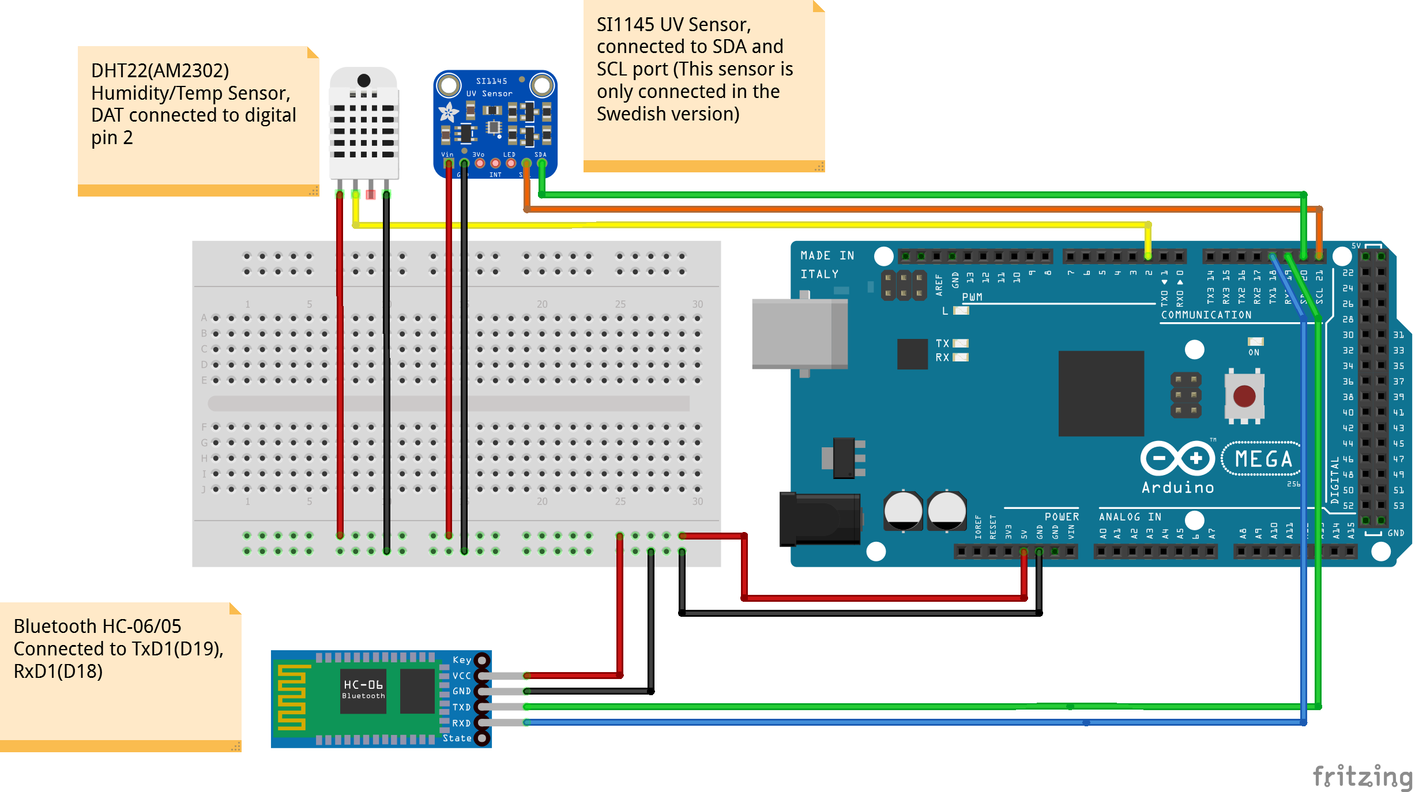



Sensor: Overview
2.1
Bluetooth Module
Temperature Humidity Sensor
Light Sensor (Only Uppsala Version)
Arduino Mega 2560
Notes:
TEAM TURKU

Slide 9

Sensor: Data
2.2
Server and Arduino are connected via Bluetooth modules
The data is fetched by our Python script who interpret data from the servers Bluetooth COM port and saves it into variables.
Python has a built in library named Serial for easy reading of COM ports.
The variables are then saved into a json format
Notes:
TEAM TURKU

Slide 10
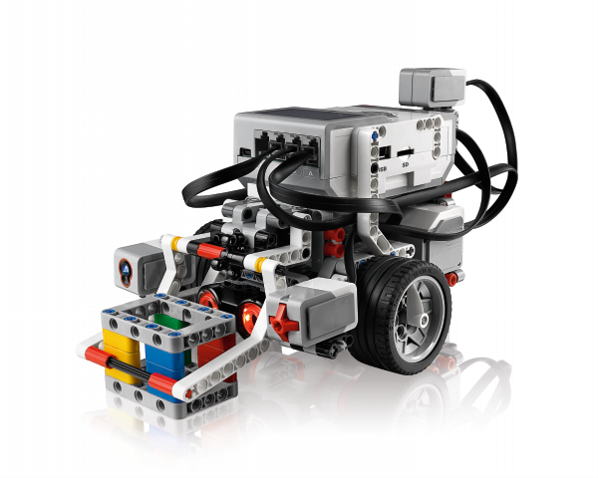
EV3: Overview
3.1
Server sends Python commands to control EV3 Robot
ev3dev OS interprets Python language and performs movement and actions
Notes:
TEAM HANOI HUST

Slide 11
EV3: Robot
3.2
Movements Robot can go forward, backward and turn left, right, around.
Line following
Algorithm that helps the robot to move in warehouse
Routing
Robot can automatically find the route of the given task
Notes:
TEAM HANOI HUST

Slide 12
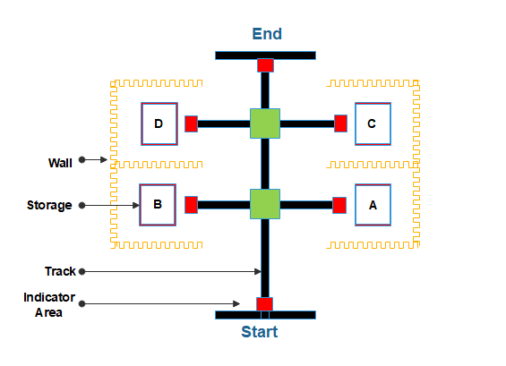
EV3: Warehouse
3.3
Notes:
TEAM HANOI HUST

Slide 13
WMS: Overview
4.1
Presents a terminal based UI
Presentation of sensor data and warehouse map
Control of EV3 robot
Connected to a database (Mariadb)
Client-Server handles communication in system
Notes:
TEAM UPPSALA
Tim talks about the server/client/database
UI - Present user with data and gives commands to the ev3
Map of warehouse
Database
Holds up to date data collected from the system
Client
Assists in communication between the different parts of the system
Server
Handles communication between the different users

Slide 14
Evaluation of result
5
How well did we do?
What could have been improved?
Notes:
TEAM UPPSALA/TURKU/HUST
Tim
How well
Pretty good, all part are present. We only need to put them all together.
Improved?
Lack of leadership from my part, should have made a clearer goal from the start
Assumed too much, they (Turuk and Hanoi) did not do what I expected they’d do
Things outside of the course took more time than i thought
The language barrier was greater than expected
Difficulty in both understanding their written and spoken english, unsure how to improve this
Division of labour was uneven
Not clear what hardware was present at what location

Slide 15
Demo Implementation
Server
Lego EV3
Sensors
Arduino
Udp
BT EV3
BT HC-05/06
Client
Local Computer
Notes:
TEAM TURKU

Slide 16
Questions?
Notes:
ALL THE TEAMS?

Slide 17
Thanks!

